Slide 1
You already know what isn't working.
The Engaged Care Staff Portal: one place for tasks, compliance, cars, forms and questions
Briefer · November 2026
Notes:
Open by listening. Ask what takes up their week before showing anything.

Slide 2
What we hear from providers like you
“I find out about an incident too late.”
“Audit week takes over everything.”
It sat in someone's inbox or a Planner card nobody opened.
Evidence is spread across folders, emails and spreadsheets.
“I chase the same things every week.”
“Our casuals can't see what they need.”
Expired checks, unfinished onboarding, tasks with no owner.
Every account costs a licence, so some staff go without.
Notes:
Pause on each one. Ask: does this sound familiar? Let them answer.

Slide 3
You're right: it isn't your people. It's the tools.
Microsoft 365 is excellent for email, Teams and documents.
It was never built for NDIS work: registers, approvals, escalation, compliance, expiry dates.
So your team fills the gaps by hand, with reminders, spreadsheets and memory.
Good people are spending their time chasing instead of supporting clients.
The work isn't the problem.
The gaps between the tools are.

Slide 4
What the gaps cost, every year
5 hours
A$11,700
1 missed
a week chasing tasks, checks and paperwork (a typical estimate)
a year of that time, at A$45 an hour
expiry or incident can cost far more at audit
Ask yourself: how many hours did your team spend chasing last week?
Notes:
Use their own numbers if they give them. The A$45 rate and 5 hours are an example only.

Slide 5
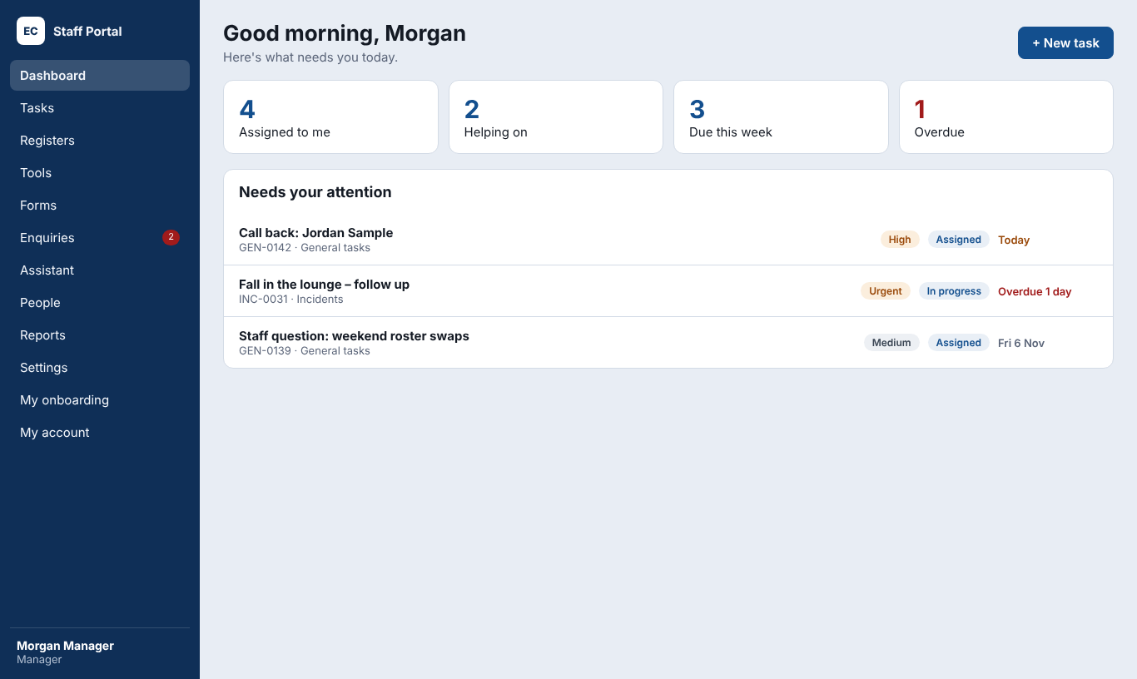
One place, so nothing falls through
Every task has an owner, a due date and a history
Overdue work escalates by itself: no chasing
Registers for incidents, complaints, risks and more
Works on computers and phones; data stays in Sydney

Slide 6
Monday morning, before and after
Today
With the portal
• Check three inboxes and Planner
• Find who's handling Friday's incident
• Work out whose first aid has expired
• Remind a new starter, again
• Ring around about the car keys
• Open the dashboard: it's all there
• The incident is assigned, with its history
• Expiring documents are flagged already
• The new starter got their reminder
• The car log shows who has which car

Slide 7
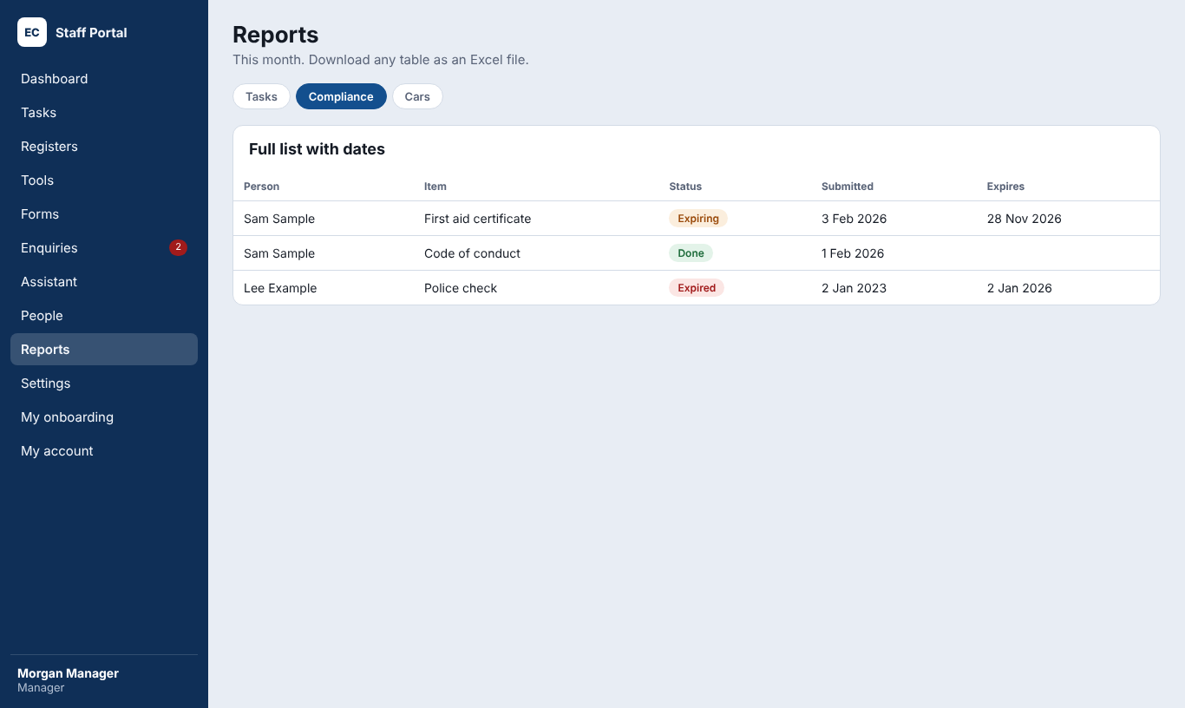
Ready on the day the auditor asks
Every check, training and certificate, with dates
Alerts before anything expires
New starters work through their own onboarding
A full history of every task and every change

Slide 8
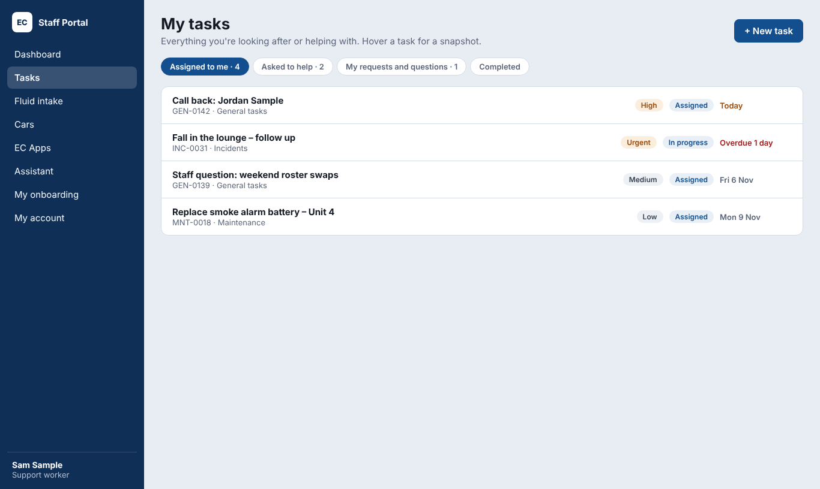
Your staff will actually use it
They see only what's theirs: simple and clear
One phone app with a PIN for cars and daily records
Questions go to the right person and get an answer
No Microsoft licence needed for casuals

Slide 9
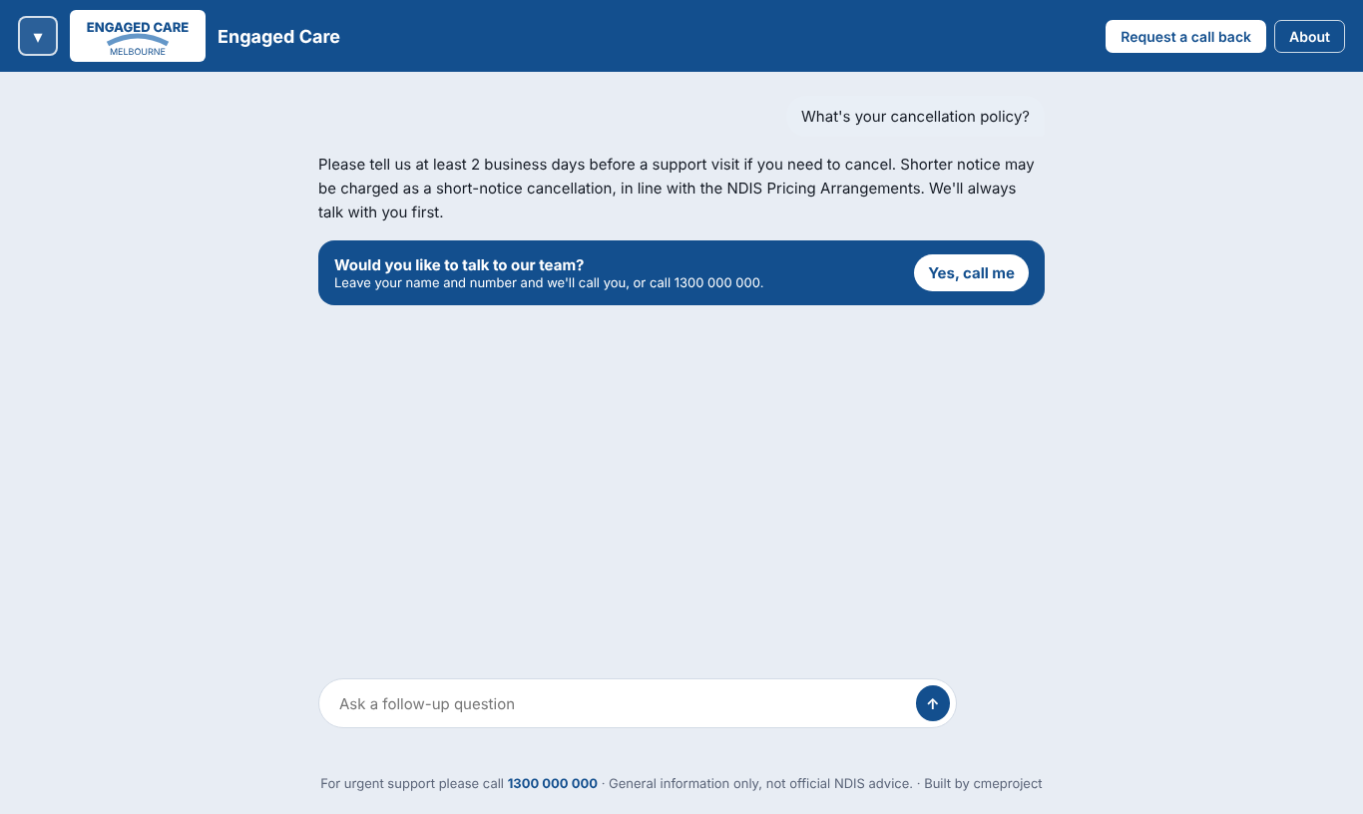
Families get answers, even after hours
Answers from your own policies, not the internet
Staff get staff-only answers when signed in
A call-back request becomes a task, due the next business day
Never misses a new enquiry

Slide 10
Safe by design
Sydney
Every table
2FA + lockout
Audited
Data stays in Australia
Protected by the database itself
Two-factor login; 5 wrong passwords lock for 15 minutes
Security reviewed November 2026

Slide 11
You keep what already works
Keep 365 for email, Teams and documents
The portal handles the work 365 was never built for
Nothing to install on computers
Start with what hurts most; add the rest when you're ready

Slide 12
Start small. Grow when you're ready.
A$290
A$790
A$14,000
a month
a month
once
Starter: the basics, up to 15 staff. Setup A$1,500, or 3 x A$500.
Everything: every module for 30 staff. Setup A$6,000.
Pay once for a permanent licence, from A$190 a month support.
Prices exclude GST. Running costs about A$75 to A$90 a month, paid to the providers.

Slide 13
Live in two weeks
Days 1 to 2
Days 3 to 5
Days 6 to 7
Days 8 to 9
Day 10
Accounts, domain, branding
Roles, registers, compliance, import
Website, documents, test the Assistant
Training and phone apps
Go live

Slide 14
Try it for a week
A week with a demo copy, using sample data
Your managers and a few staff try their real daily work
We meet at the end of the week: keep what fits, drop what doesn't
If it's right for you, we start setup the week after
Notes:
Close with the trial, not the price. Agree the trial dates before you leave.

